Slide 1
What Influences Underage Weekend Drinking?
By Tayleigh Trussell, Dinc Ergin, Artemid Leskaj, Toni Abiru, Jon Tehrani

Slide 2
Table of Contents
Purpose of Analysis
Descriptive Statistics
Multiple Regression
ANCOVA

Slide 3
Purpose of Analysis
Understand the factors that contribute to underage drinking.
Results can be used to assist schools and high school programs that are looking to decrease or prevent underage drinking among its students.

Slide 4
Main Findings
The following variables are statistically significant: gender, workday drinking, likelihood to go out with friends, weekly study time, quality of family relationship, student’s health status and type of guardian (mother, father or other)
With these inputs, a multiple regression model is able to account for 44% of the variation in weekend drinking, with 95% confidence.
A percentage increase in weekday drinking increases weekend drinking by 0.61 percent, holding all other variables constant.
Adjusting for the covariate (free time) we can see that the number of drinks on the weekend increases at the Mousinho da Silveira School.

Slide 5
Descriptive Statistics

Slide 6
Summary of Numeric Variables
650 Observations
33 Variables
Outcome Variable - Weekend alcohol consumption (Walc) amongst students
We’ll explore any unusual observations throughout our analysis
Variables | Mean | Minimum | Maximum
Weekend drinking (Walc) | 2.28 | 1 | 5
Workday drinking (Dalc) | 1.502 | 1 | 5
Student’s age | 16.74 | 15 | 22
Weekly study time | 1.931 | 1 | 4
Going out with friends | 3.185 | 1 | 5
Free time after school | 3.18 | 1 | 5
Notes:
650 students across 2 different schools
33 different variable
We’re looking to see the alcohol consumption amongst the students from the 2 different schools.
As we’re working on our analysis we’ll explore any unusual observations.

Slide 7
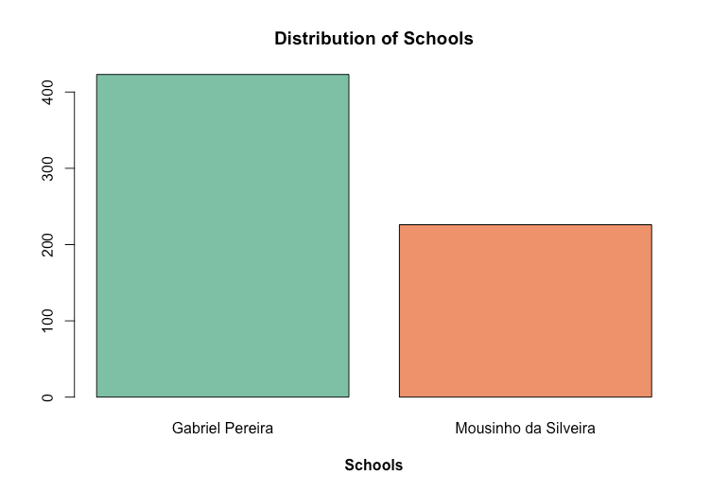
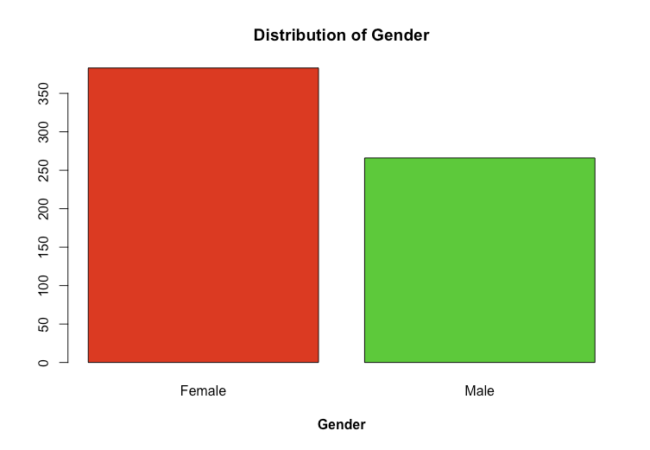
Data Distributions
Notes:
Here we have the data distribution of schools. Gabriel Pereira has the larger student count.
When looking at the Genders, there are more female students than male

Slide 8
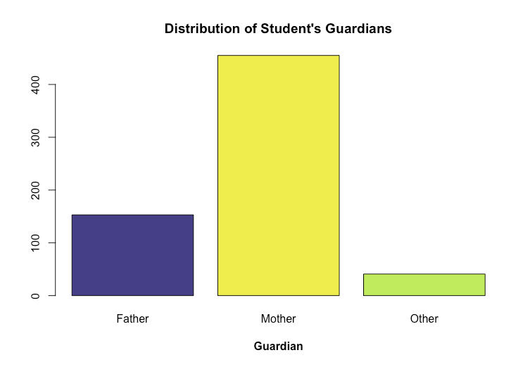
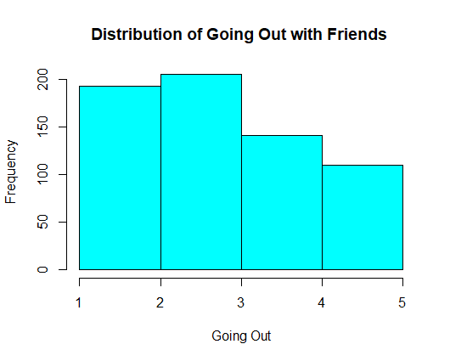
Data Distributions
Notes:
When looking at the guardians, we see that Mother’s are the largest majority, followed by Father’s and Other’s.
When looking at the Distribution of going out, we see most students have said 1 or 2 out of 5 in terms of how often they go out.

Slide 9
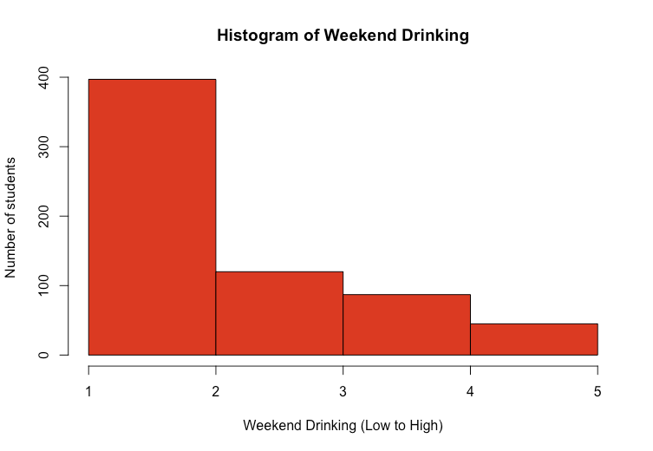
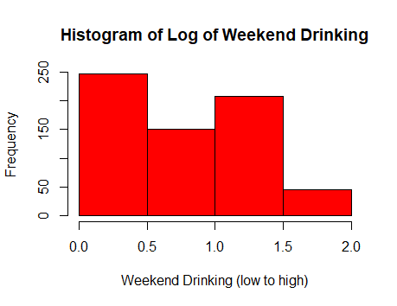
Data Distribution (Log Changes)
Notes:
In total we implemented log transformation for 3 variables: weekend drinking, workday drinking and study time.
We’re using the log-transformed data because they are clearer and more normal. They’re also unimodal, symmetric and don’t have much skewness.

Slide 10
Multiple Regression

Slide 11
Multiple Regression - Model
Dependent Variable: Weekend Alcohol Consumption(Continuous)
Independent Variables: Work day drinking, sex, study time, quality of family relationships, current health status, and type of guardian
 | Coefficient | P-Value
Intercept | 0.09 | 0.41
DalcLog | 0.61 | 2e-16***
goout | 0.12 | 2.76-15***
sexM | 0.13 | 0.0004***
studytimeLog | -0.12 | 0.004**
 | Coefficient | P-Value
famrel | -0.06 | 0.002**
health | 0.03 | 0.02*
guardianfather | 0.14 | 0.07 .
guardianmother | 0.15 | 0.03*
R-squared: | 0.44
Notes:
Our best model with only significant variables predict weekend alcohol consumption with weekday alcohol consumption, going out frequency, gender, study time, quality of family relationships, healthiness of the student and registered parental guardian of the student

Slide 12
Multiple Regression - Interpretation
Male weekend alcohol consumption is 0.13 higher than female weekend alcohol consumption, holding all other variables constant.
A percentage increase in weekday drinking increases weekend drinking by 0.61 percent, holding all other variables constant.
A percentage increase in study time decreases alcohol consumption by 0.12, holding all other variables constant.

Slide 13
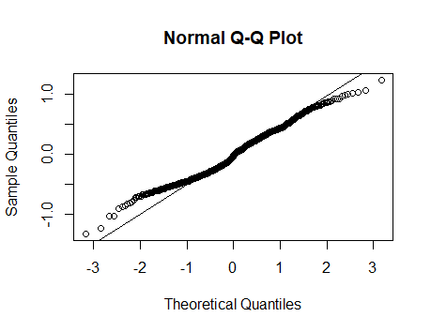
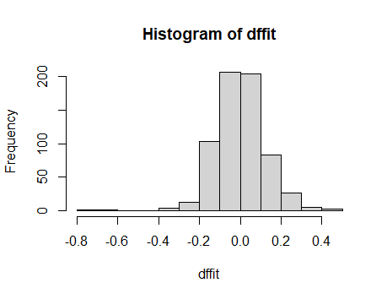
Multiple Regression - Assumptions
No influential points.
No multicollinearity issues.
Low VIF Scores for all variables
Linearity assumption is violated
Notes:
With Cook’s method, we don’t have any data points with cook’s distance over 1. When looking at the dffit outliers, there are no data points over the value 1 and -1. Since there are no outliers in both methods, we can conclude that there are no influential points that can be problematic.

Slide 14
ANCOVA

Slide 15
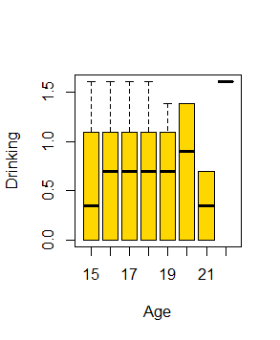
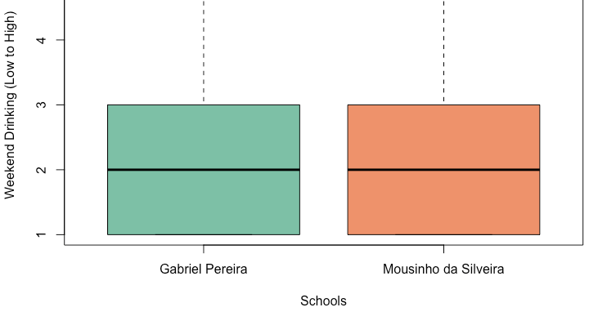
ANCOVA - Model 1
Dependant Variable: Walc (Continuous)
Independent Variable: School (Categorical)
Covariate: Age (continuous)
Notes:
We saw that the standard deviations and means for the schools, Gabriel Pereira and Mousinho da Silveira are close to one another

Slide 16
ANCOVA - Model 1 Results
We use Levene’s Test to test for homogeneity of variance.
Our high p-value of 0.16 meant that the test passed.
Next, we needed to check for independence of our covariate, age, and our independent variable, school.
The p-value was low at 0.026 which means that there was a difference in age across the groups of school.
Thus, we needed to choose another covariate.

Slide 17
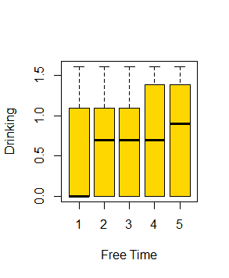
ANCOVA - Model 2
Dependent Variable: Walc (Continuous)
Independent Variable: School (Categorical)
Covariate: Free Time (continuous)

Slide 18
ANCOVA - Model 2 Findings
We need to check for independence of our covariate, freetime, and our independent variable, school.
The p-value was high at 0.378 which means that there was NOT a difference in freetime across the groups of school.
Thus, we can assume that the variables are independent.
We then adjust for the covariate and can see that the number of drinks on the weekend increases at the Mousinho da Silveira School.
 | Gabriel Pereira | Mousinho da Silveira
School Effect | 0.652 | 0.678
Lower 95 Percentile Confidence Limits | 0.597 | 0.602
Higher 95 Percentile Confidence Limits | 0.707 | 0.753

Slide 19
ANCOVA - Model 2
Type II Test
 | P-Value
Free Time | 0.004
School | 0.583

Slide 20
In Conclusion

Slide 21
Concluding Thoughts
Adjusting for the covariate we can see that the number of drinks on the weekend increases at the Mousinho da Silveira School.
Male weekend alcohol consumption is 0.13 higher than female weekend alcohol consumption, holding all other variables constant.
A percentage increase in weekday drinking increases weekend drinking by 0.61 percent, holding all other variables constant.
A percentage increase in study time decreases alcohol consumption by 0.12, holding all other variables constant.

